Slide 1
Technology, Screen Time, and Their Effects on Mental Health
Nisa Kan 31999

Slide 2
MY DATASET
User_ID: Anonymized unique identifier
Age & Gender: Demographic information
Technology_Usage_Hours: Daily time spent using digital devices
Social_Media_Usage_Hours: Hours spent specifically on social media
Gaming_Hours: Time spent playing games on a daily basis
Screen_Time_Hours: Total screen exposure per day
Sleep_Hours: Daily sleep duration in hours
Stress_Level: Self-reported (Low, Medium, High) → converted to numerical scale (1–3)
Mental_Health_Status: General mental well-being status (e.g., stable, moderate, struggling)
Physical_Activity_Hours: Exercise or active hours per day
Support_Systems_Access: Whether the individual has access to emotional or social support
Work_Environment_Impact: How work setting affects stress (e.g., high-pressure, balanced)
Online_Support_Usage: Use of digital tools or communities for mental support

Slide 3
HYPOTHESIS
Null Hypothesis (H₀):
There is no correlation between screen time sleep hours.
Alternative Hypothesis (H₁):
There is a correlation between screen time and sleep hours.

Slide 4
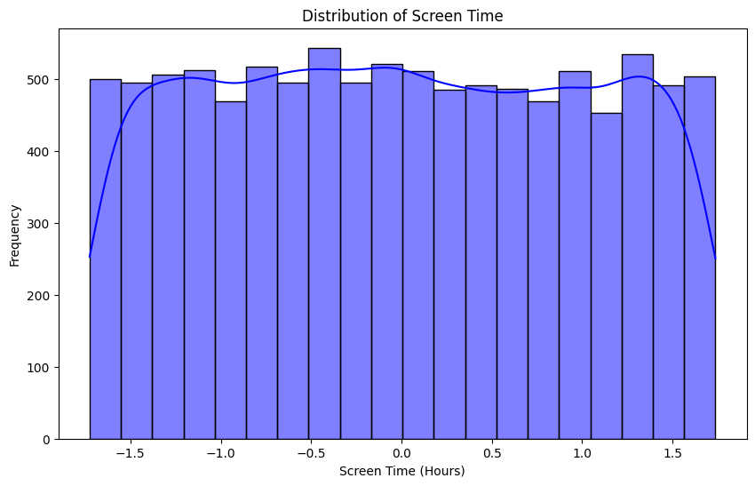
UNIVARIATE ANALYSIS
Technology Usage Histogram
Screen time is fairly evenly distributed across the sample, with most individuals using screens between 2 and 14 hours daily. There is no sharp peak, suggesting a wide variety of usage habits.
Histogram

Slide 5
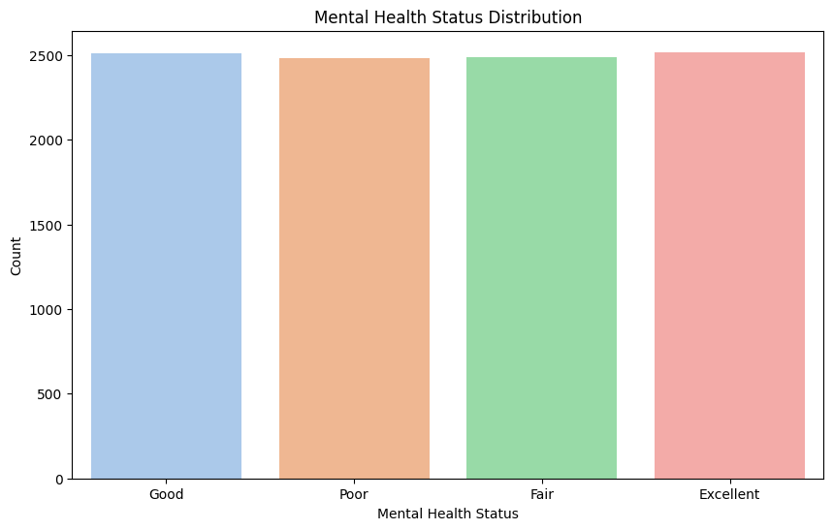
UNIVARIATE ANALYSIS
Mental health status is evenly distributed across all categories, indicating a balanced dataset with similar representation for Excellent, Good, Fair, and Poor mental health groups.
Histogram

Slide 6
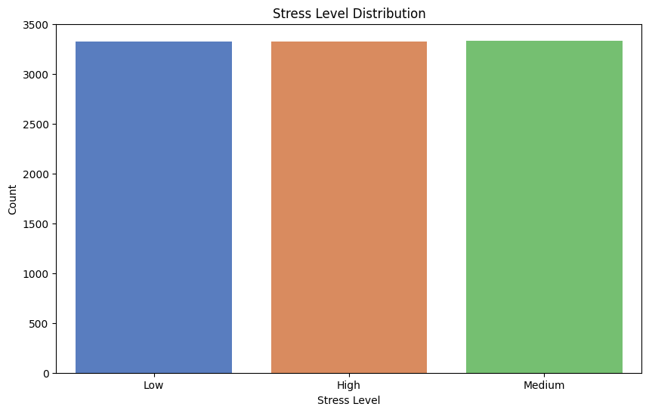
UNIVARIATE ANALYSIS
Stress levels are almost evenly distributed across low, medium, and high categories, indicating a well-balanced sample for stress-related analysis.
Histogram

Slide 7
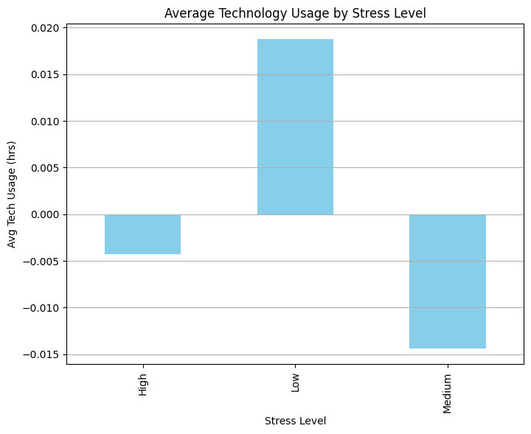
UNIVARIATE ANALYSIS
Average Tech Usage by Stress Level
Low-stress individuals use technology slightly more on average. Medium-stress users show the lowest usage, suggesting a possible link between moderate stress and reduced tech use.

Slide 8
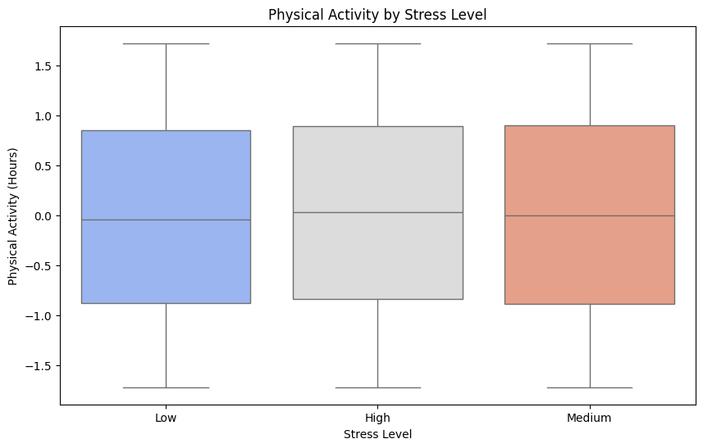
BIVARIATE ANALYSIS
Physical Activity by Stress Level
Individuals with lower stress levels tend to report higher levels of physical activity, while highly stressed individuals show lower activity ranges.
Boxplot

Slide 9
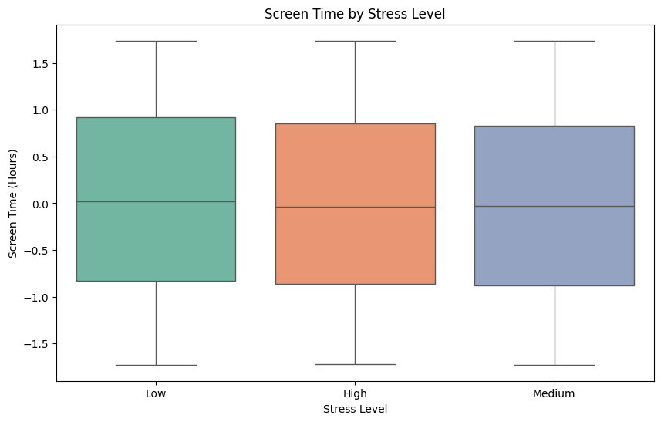
BIVARIATE ANALYSIS
Screen time by stress level
Screen time appears similar across all stress levels, with slightly higher medians for low stress. This suggests that screen time alone may not strongly differentiate between stress categories.
Boxplot

Slide 10
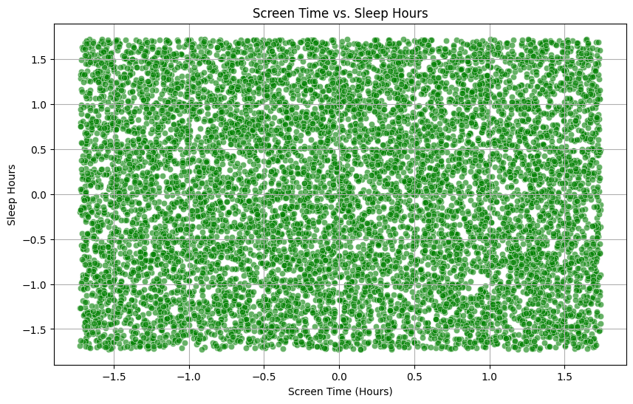
BIVARIATE ANALYSIS
There is no clear trend between screen time and sleep hours, suggesting that increased screen use does not strongly predict changes in sleep duration in this dataset.
Scatterplot

Slide 11
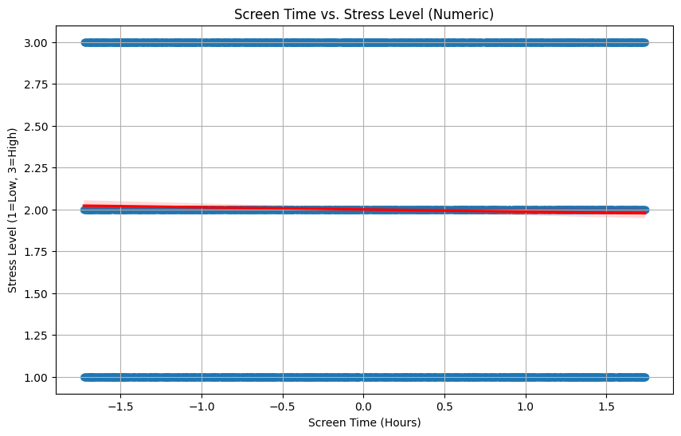
BIVARIATE ANALYSIS
There is no clear linear relationship between screen time and stress level, as stress appears uniformly distributed across different screen time durations.

Slide 12
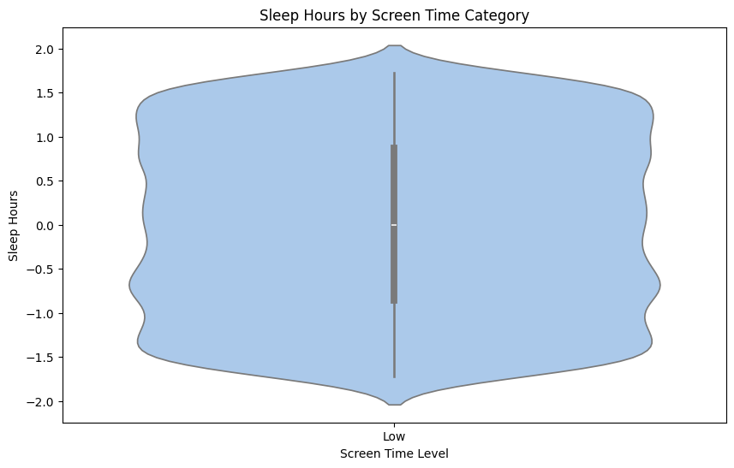
BIVARIATE ANALYSIS
The plot shows a symmetric distribution of sleep hours for low screen time users, centered around the mean. Most values cluster near the center, indicating consistent sleep patterns.

Slide 13
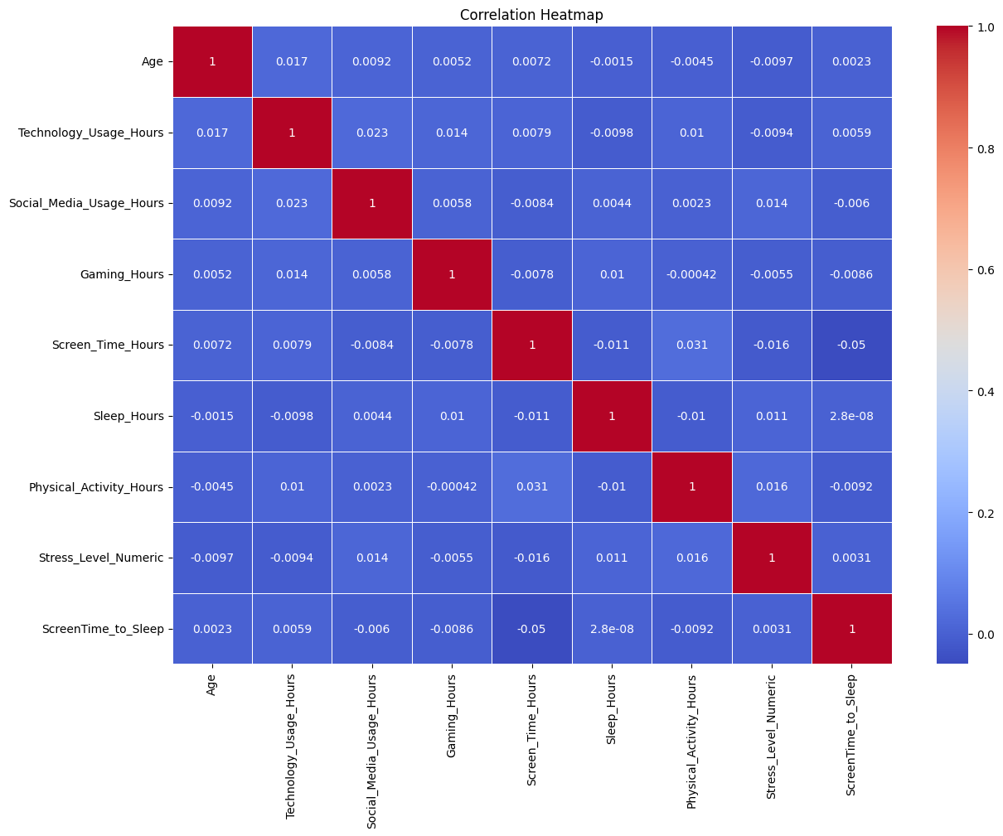
MULTIVARIATE ANALYSIS
Most variables show weak or no correlation, but screen time has a strong positive correlation with the screen-to-sleep ratio (0.89) and a moderate negative correlation with sleep duration (-0.41), suggesting that more screen time may reduce sleep.
Correlation Heatmap

Slide 14
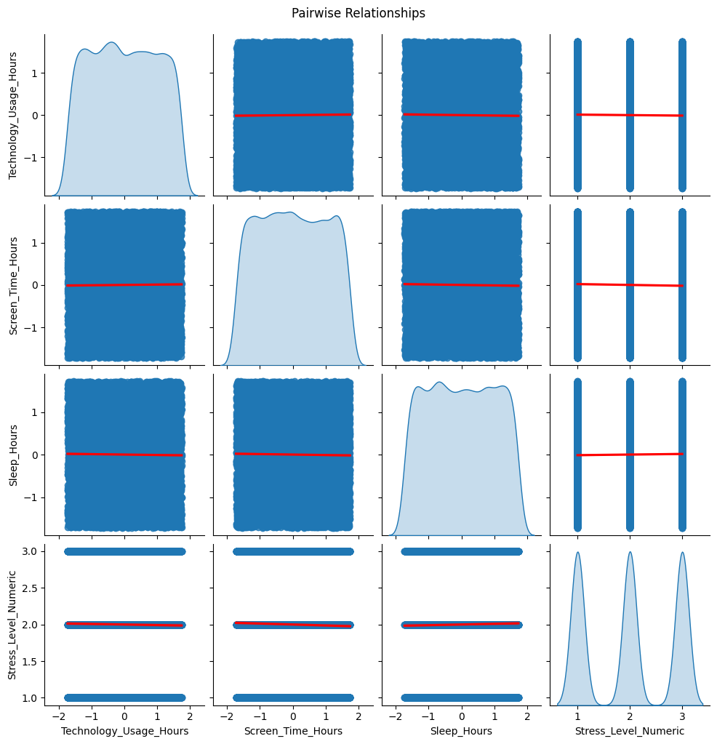
MULTIVARIATE ANALYSIS
Most pairwise relationships appear weak or flat, indicating little linear association between variables. However, there's a slight negative trend between screen time and sleep hours, and stress levels show no strong connection to technology or screen use.
Pairplot

Slide 15
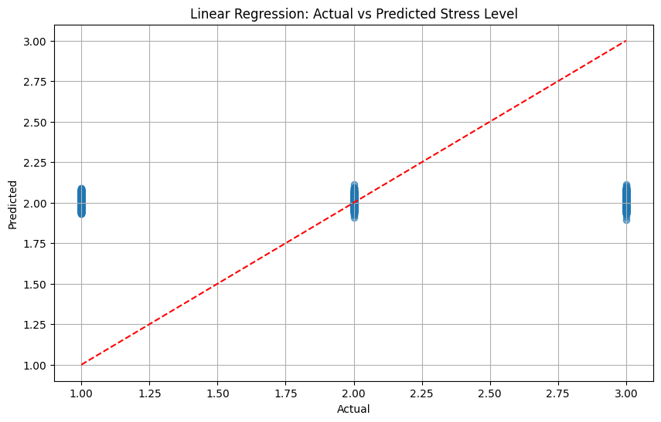
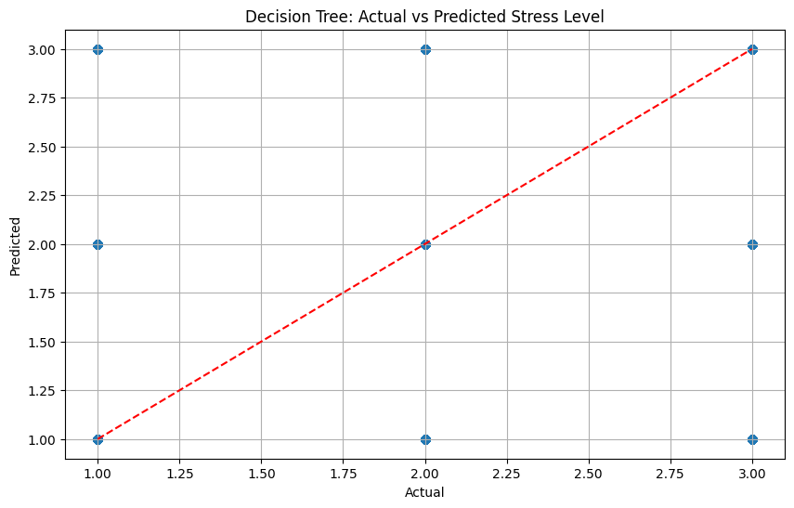
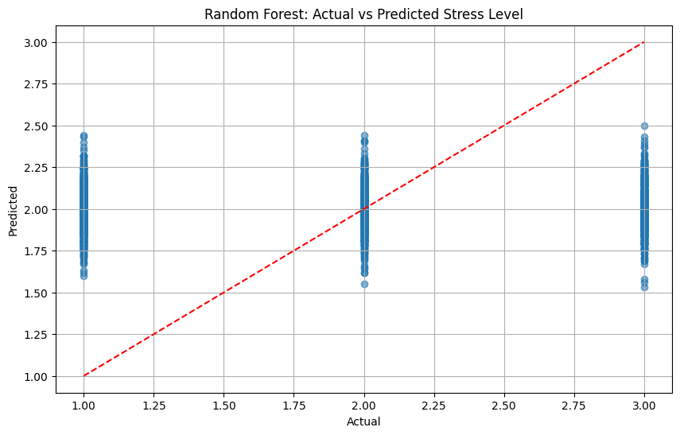
REGRESSION ANALYSIS
Linear Regression:
MSE: 0.68
R²: -0.00
Decision Tree:
MSE: 1.28
R²: -0.90
Random Forest:
MSE: 0.69
R²: -0.03

Slide 16
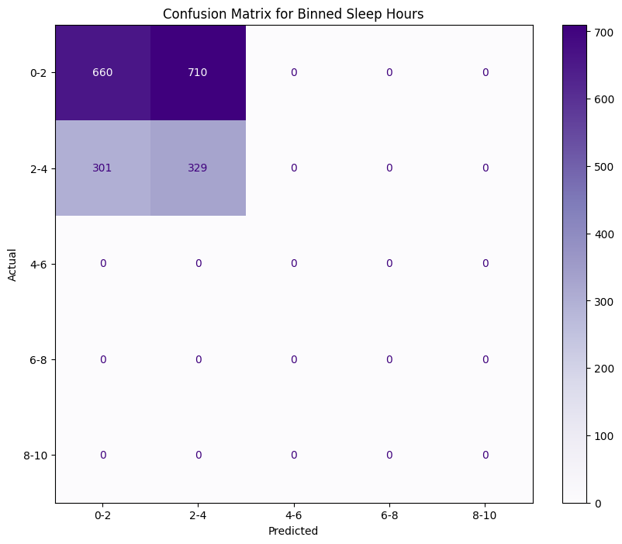
CONFUSION MATRIX FOR BINNED SLEEP HOURS
The confusion matrix shows that the model only predicts sleep hours in the 0–4 range, missing all higher categories. This indicates poor model performance and a strong class imbalance.

Slide 17
CONCLUSION
Pearson Correlation Coefficient: -0.02
P-Value: 0.1063
The p-value is greater than or equal to 0.05.
We fail to reject the null hypothesis.

